Slide 1





Kong API Gateway and Services
Kong API Gateway and same service on two regions
Distributed Service Mesh
AWS
Azure
Microservices
Microservices
Microservices
Microservices
Microservices
Consumers
Kong Enterprise
Services
AWS
Azure - Region 1
Microservice X
Consumers
Kong Enterprise
Azure - Region 2
Microservice X
AWS
Azure
Kong Mesh
Kong Mesh
Microservice
Microservice

Slide 2




Distributed Service Mesh
AWS - Region 2
Kong Mesh
AWS - Region 1
Microservice
Consumers
Kong Enterprise
Azure - Region 1
Azure - Region 2
Kong Mesh
Kong Mesh
Microservice
Microservice
Layers 4-7
Layers 1-4
End-to-end security
Ingress and Egress Access Control
High Availability for Connectivity
Centralized Controller
Visual Multi-Cloud Topology Mapping
Private IP
Private IP
Private IP
OnPrem

Slide 3
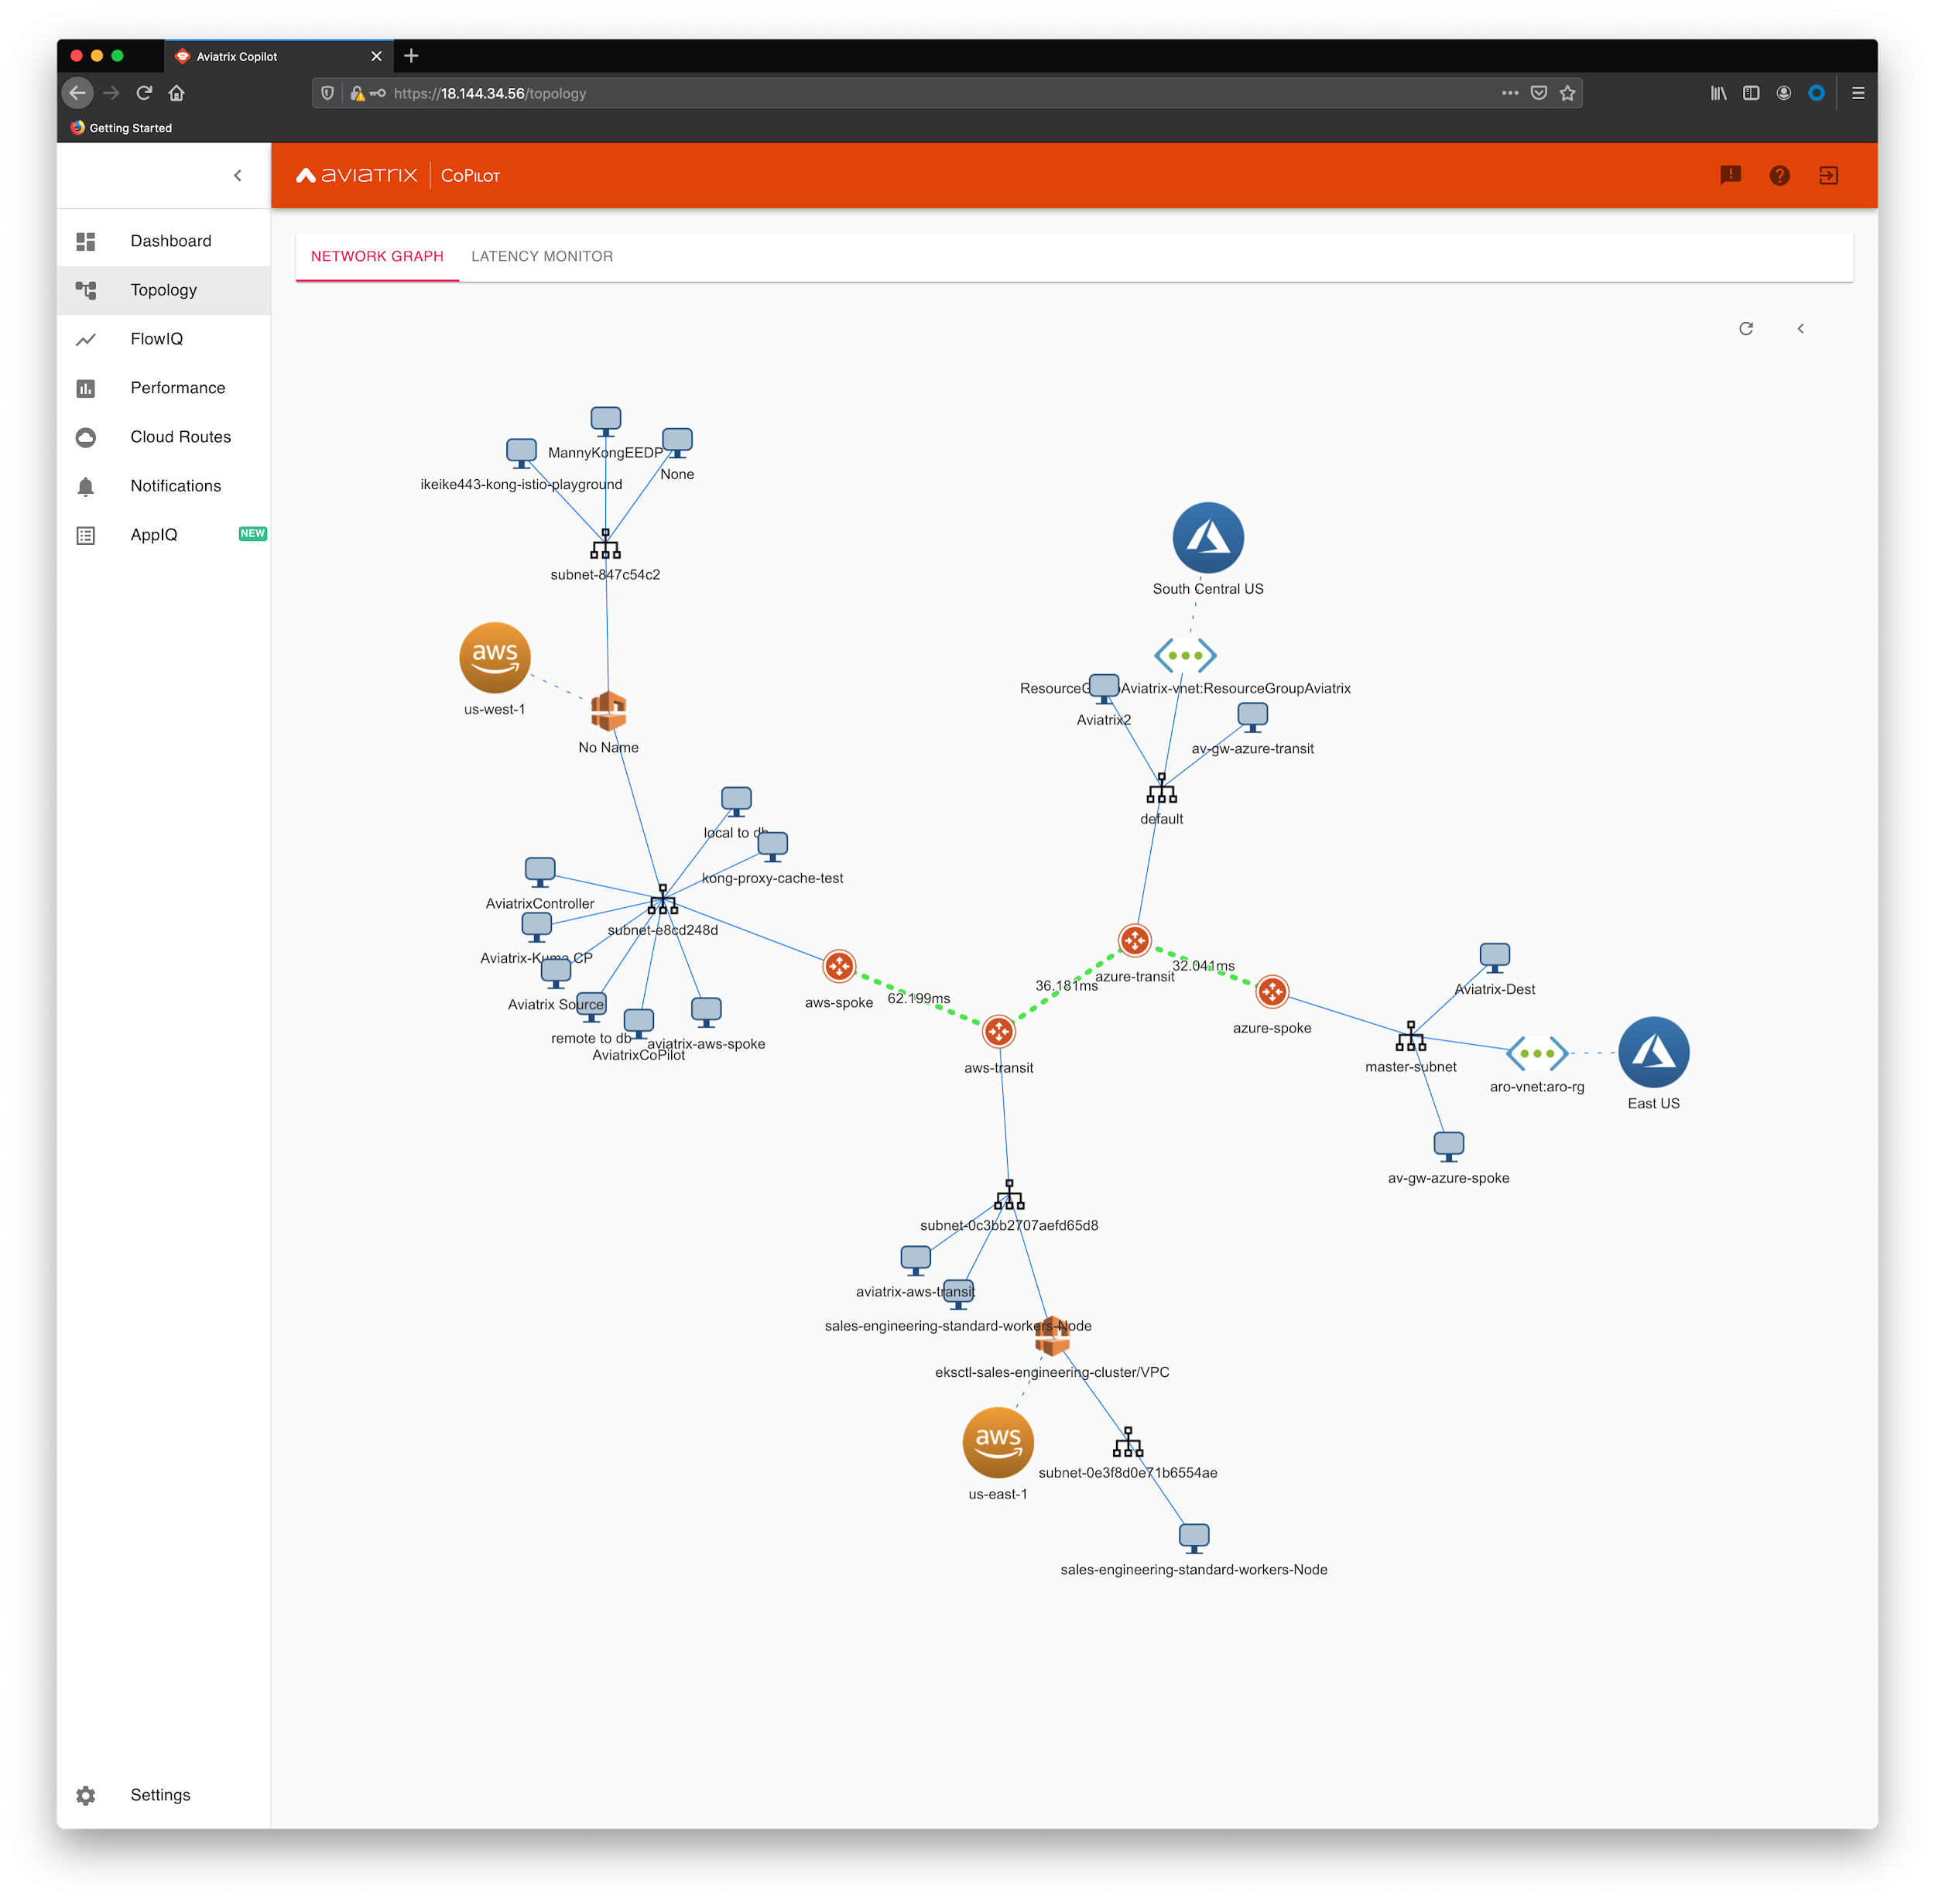

Slide 4
Kong, Kuma and Aviatrix
Distributed Service Mesh
AWS - Region 1
AWS - Region 2
Consumers
Kong Enterprise
Kong Mesh
Microservice
Azure - Region 1
Azure - Region 2
Kong Mesh
Kong Mesh
Microservice
Microservice

Slide 5
API Gateway and Service Mesh
Consumers
Service Mesh
API Gateway
Sidecar
Microservice
Sidecar
Microservice
Microservice
Sidecar
Sidecar
Service Mesh
Control Plane

